Slide 1
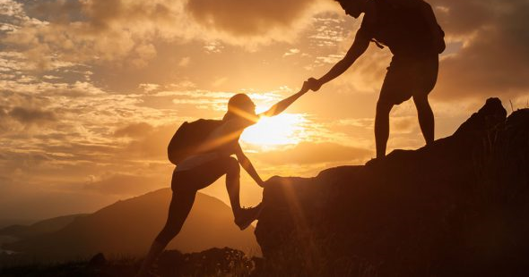
Blessed to be a blessing
Elder Aaron Evans

Slide 2
Genesis 12:1-3
1 Now the Lord had said unto Abram, Get thee out of thy country, and from thy kindred, and from thy father's house, unto a land that I will shew thee:
² And I will make of thee a great nation, and I will bless thee, and make thy name great; and thou shalt be a blessing:
³ And I will bless them that bless thee, and curse him that curseth thee: and in thee shall all families of the earth be blessed.

Slide 3
Matthew 5:1-12
5 And seeing the multitudes, he went up into a mountain: and when he was set, his disciples came unto him:
² And he opened his mouth, and taught them, saying,
³ Blessed are the poor in spirit: for theirs is the kingdom of heaven.
⁴ Blessed are they that mourn: for they shall be comforted.
⁵ Blessed are the meek: for they shall inherit the earth.
⁶ Blessed are they which do hunger and thirst after righteousness: for they shall be filled.

Slide 4
Matthew 5:1-12
⁷ Blessed are the merciful: for they shall obtain mercy.
⁸ Blessed are the pure in heart: for they shall see God.
⁹ Blessed are the peacemakers: for they shall be called the children of God.
¹⁰ Blessed are they which are persecuted for righteousness' sake: for theirs is the kingdom of heaven.
¹¹ Blessed are ye, when men shall revile you, and persecute you, and shall say all manner of evil against you falsely, for my sake.
¹² Rejoice, and be exceeding glad: for great is your reward in heaven: for so persecuted they the prophets which were before you.

Slide 5
What does it mean to be blessed?

Slide 6
Deuteronomy 28:3-5
³ Blessed shalt thou be in the city, and blessed shalt thou be in the field.
⁴ Blessed shall be the fruit of thy body, and the fruit of thy ground, and the fruit of thy cattle, the increase of thy kine, and the flocks of thy sheep.
⁵ Blessed shall be thy basket and thy store.
God’s favour in all areas

Slide 7
Matthew 7:11
¹¹ If ye then, being evil, know how to give good gifts unto your children, how much more shall your Father which is in heaven give good things to them that ask him?
Good-good Father
But what happens when things are not looking good?

Slide 8
Jesus on being blessed…
In the Greek blessed = Μακάrios; receiving God’s favour or to be happy.
But it also means more than this, as seen in Matthew 5 to be completely satisfied or content (self-contained).

Slide 9
Old or New Testament?
Matthew 5:17
¹⁷ Think not that I am come to destroy the law, or the prophets: I am not come to destroy, but to fulfil.
Fulfil = accomplish, achieve, demonstrate, live out or embody.
Jesus is the plan to bless us!

Slide 10
The real blessing
Ezekiel 36:28
²⁸ And ye shall dwell in the land that I gave to your fathers; and ye shall be my people, and I will be your God.
The greatest blessing is God.
Matthew 19 – The rich man missed that.
Disciples believed health and wealth was the proof of blessing.
Relationship is key.

Slide 11
The place of blessing
Psalm 91:1
He that dwelleth in the secret place of the most High shall abide under the shadow of the Almighty.
Jeremiah 17:7-8
⁷ Blessed is the man that trusteth in the Lord, and whose hope the Lord is.
⁸ For he shall be as a tree planted by the waters, and that spreadeth out her roots by the river, and shall not see when heat cometh, but her leaf shall be green; and shall not be careful in the year of drought, neither shall cease from yielding fruit.
John 15:5 + 7
⁵ I am the vine, ye are the branches: He that abideth in me, and I in him, the same bringeth forth much fruit: for without me ye can do nothing.
⁷ If ye abide in me, and my words abide in you, ye shall ask what ye will, and it shall be done unto you.

Slide 12
Restoration
Following Adam and Eve’s exile from Eden.
The place of blessing and fellowship they enjoyed.
But a place not just for Abraham.
Oldest and greatest love story of all time – God moves to restore humanity to its place of blessing.

Slide 13
Go!
Begins by telling him to get out/go.
Leave what he knew or relied on and trust God.
From a (geographical) land to a temple – to an Ark – to their hearts – to their spirit.
1 Corinthians 3:16
‘Know ye not that ye are the temple of God, and that the Spirit of God dwelleth in you?’
He wants to be close to you.
We GO to God.

Slide 14
Our place of blessing in Him
1 John 4:13
‘Hereby know we that we dwell in him, and he in us, because he hath given us of his Spirit.’
Promises of blessing fulfilled in Jesus.
Galatians 3:14 + 16
14 That the blessing of Abraham might come on the Gentiles through Jesus Christ; that we might receive the promise of the Spirit through faith. 16 Now to Abraham and his seed were the promises made. He saith not, And to seeds, as of many; but as of one, And to thy seed, which is Christ.
We find our place of blessing in Christ.

Slide 15
The origin of Blessings
Philippians 4:19
19 But my God shall supply all your need according to his riches in glory by Christ Jesus.
James 1:17
17 Every good gift and every perfect gift is from above, and cometh down from the Father of lights, with whom is no variableness, neither shadow of turning.
Matthew 5:45
45 That ye may be the children of your Father which is in heaven: for he maketh his sun to rise on the evil and on the good, and sendeth rain on the just and on the unjust.
It is a gift of God.
1 Timothy 6:17
17 Charge them that are rich in this world, that they be not highminded, nor trust in uncertain riches, but in the living God, who giveth us richly all things to enjoy;

Slide 16
The purpose of our blessings
Not just for Abraham but his seed. (v2)
Blessed so that others might be blessed. (v3)
Channel or vessel of his blessings.
Our part in this restoration plan.
As Abraham – children of Israel – Jesus – calls us to continue the flow.
Flow of love and blessing from God to us and to others.

Slide 17
The purpose of our blessings
Matthew 22:36-40.
³⁶ Master, which is the great commandment in the law?
³⁷ Jesus said unto him, Thou shalt love the Lord thy God with all thy heart, and with all thy soul, and with all thy mind.
³⁸ This is the first and great commandment.
³⁹ And the second is like unto it, Thou shalt love thy neighbour as thyself.
⁴⁰ On these two commandments hang all the law and the prophets.

Slide 18
Blessed to be a blessing
Luke 4:18
18 The Spirit of the Lord is upon me, because he hath anointed me to preach the gospel to the poor; he hath sent me to heal the brokenhearted, to preach deliverance to the captives, and recovering of sight to the blind, to set at liberty them that are bruised,
What we have is for others.
Matthew 10: 7-8
7 And as ye go, preach, saying, The kingdom of heaven is at hand.
8 Heal the sick, cleanse the lepers, raise the dead, cast out devils: freely ye have received, freely give.

Slide 19
Who has been a blessing to us?
Parents? Siblings? wider family? friends? acquaintances? strangers?
How has that impacted us?
Appreciation of God and others.

Slide 20
1)How can we be a blessing? & 2)What are the barriers to us being a blessing?
Be very practical using examples

Slide 21
How can we be a blessing?
1) Help those in a less favourable position to us.
2) Help others to find their place in God.

Slide 22
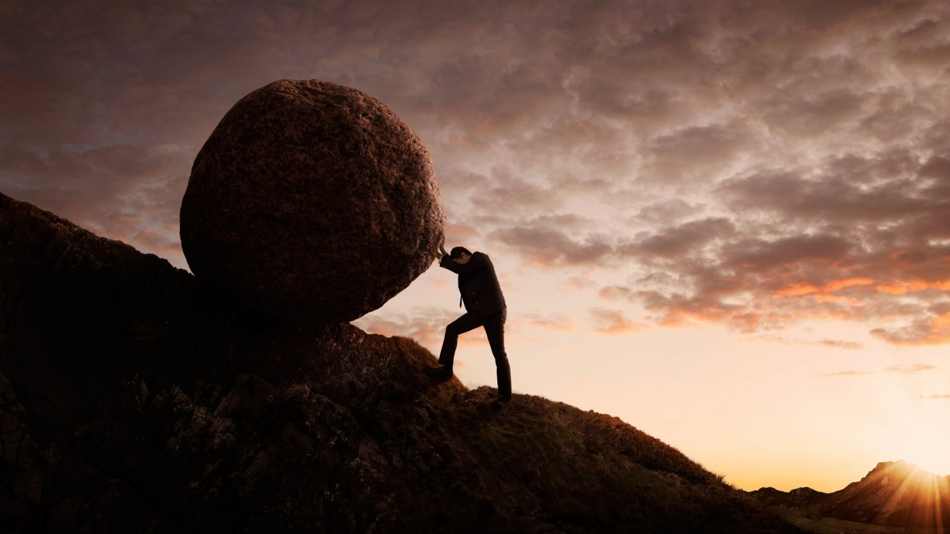
What are the challenges to being a blessing?
Fear
Self doubt
Wrong focus
Lack of knowledge
Burn out

Slide 23
Overcoming challenges to being a blessing
Trust God
A special role in God’s plan
God has given you what you need
Read, mediate, pray, learn
Self-care

Slide 24
Blessed to be a blessing
Elder Aaron Evans

